Slide 1
Hive
Big Data Spark Project 1

Slide 2

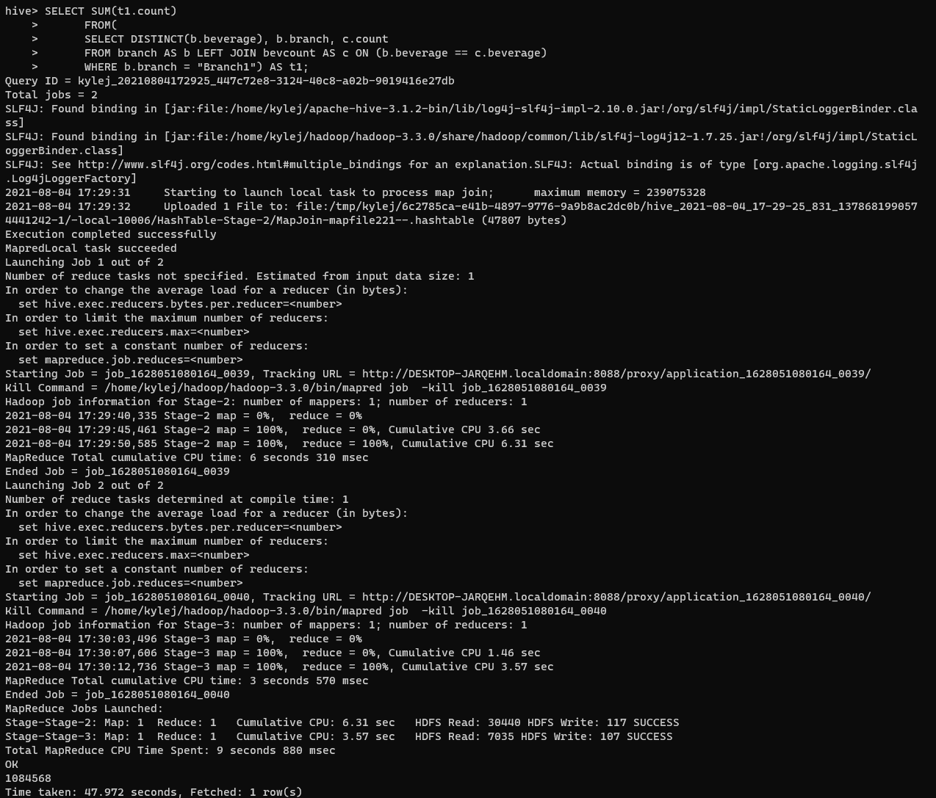
Problem Scenario 1
What is the total number of consumers for Branch 1?

Slide 3
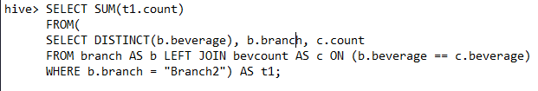
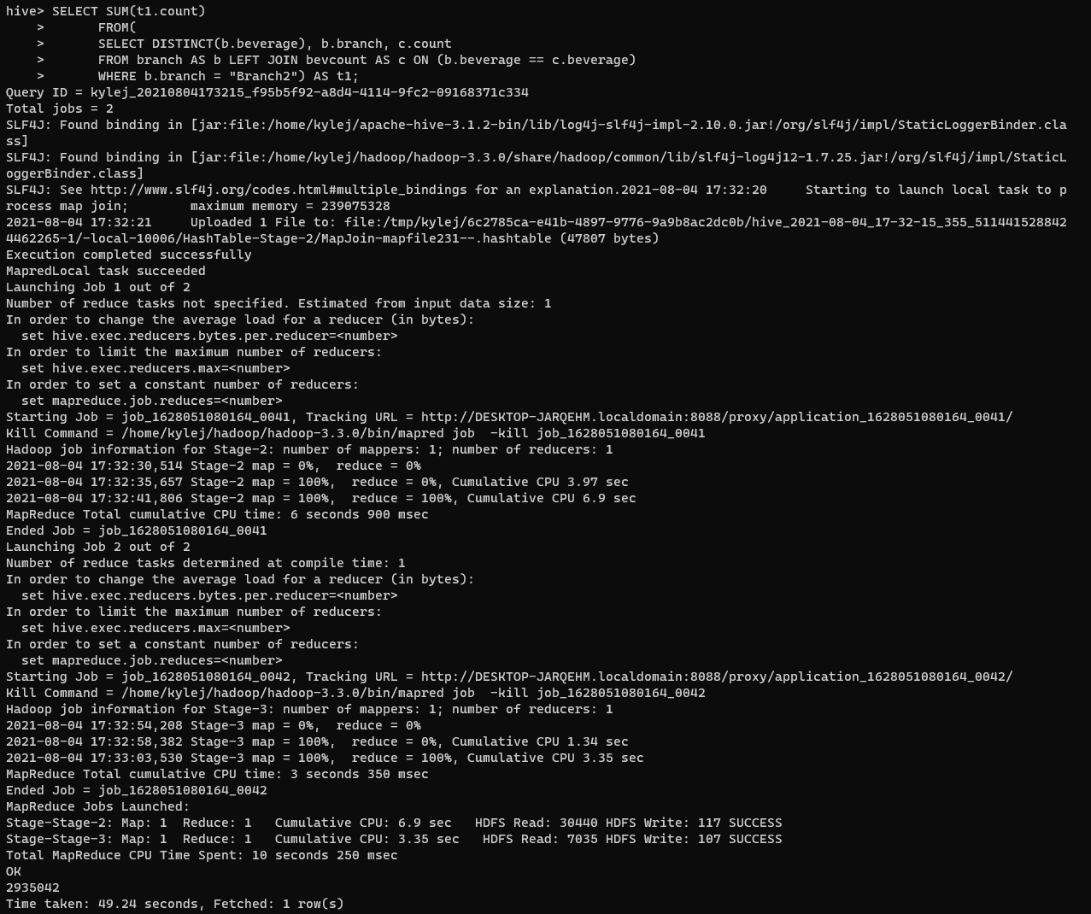
Problem Scenario 1
What is the number of consumers for the Branch2?

Slide 4
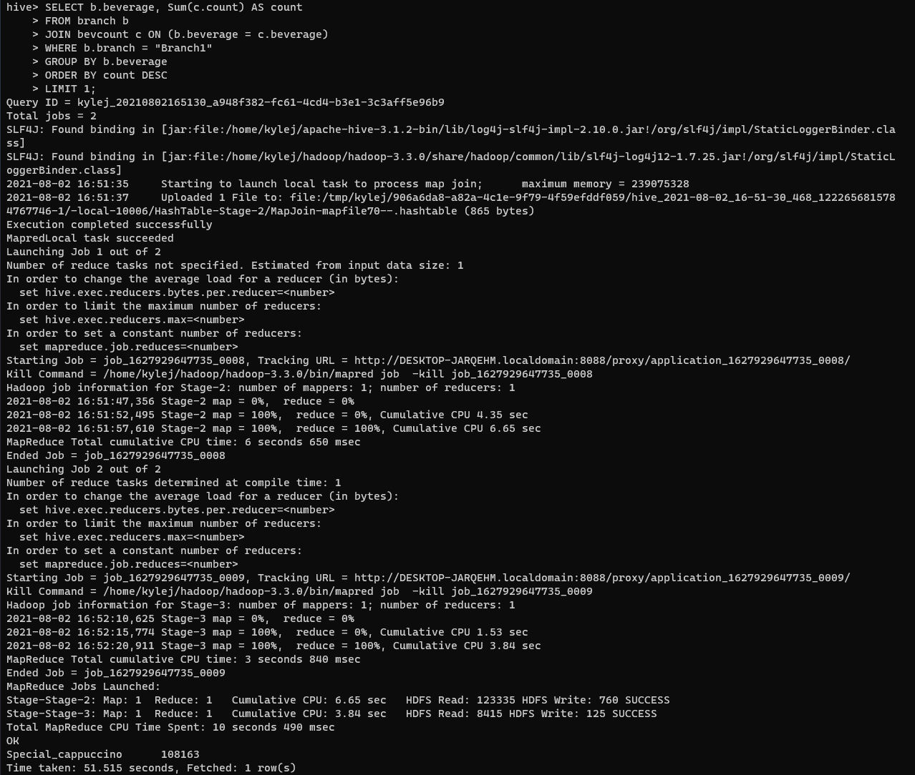
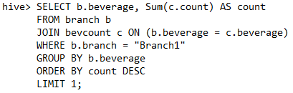
Problem Scenario 2
What is the most consumed beverage on Branch1?

Slide 5
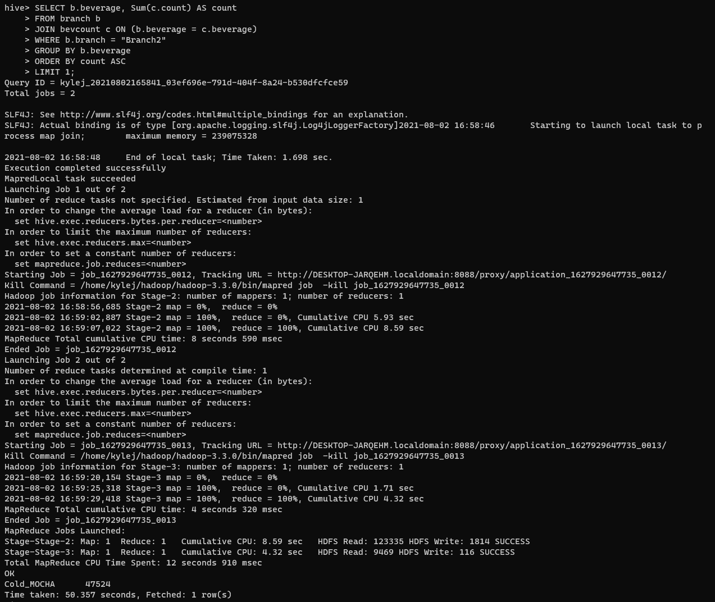
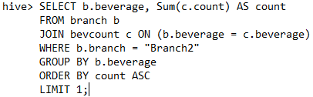
Problem Scenario 2
What is the least consumed beverage on Branch2?

Slide 6
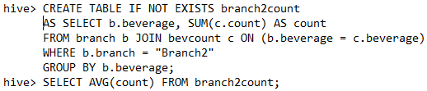
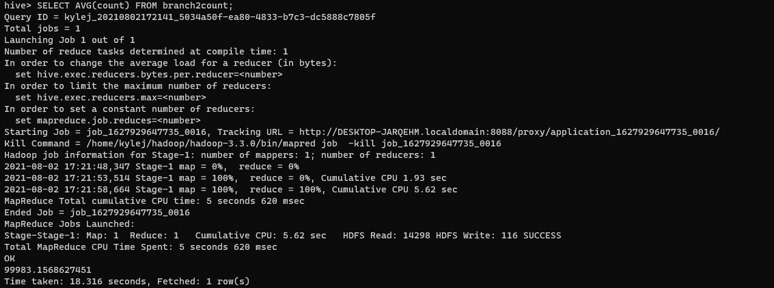
Problem Scenario 2
What is the Average consumed beverage of Branch2?

Slide 7

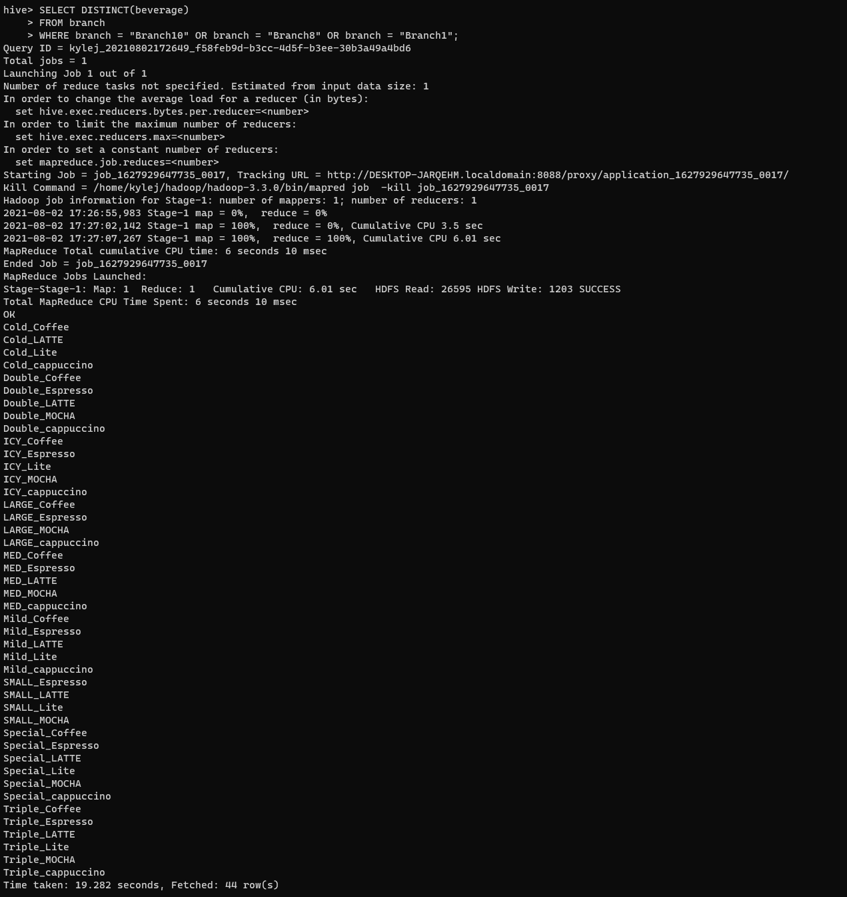
Problem Scenario 3
What are the beverages available on Branch10, Branch8, and Branch1?

Slide 8
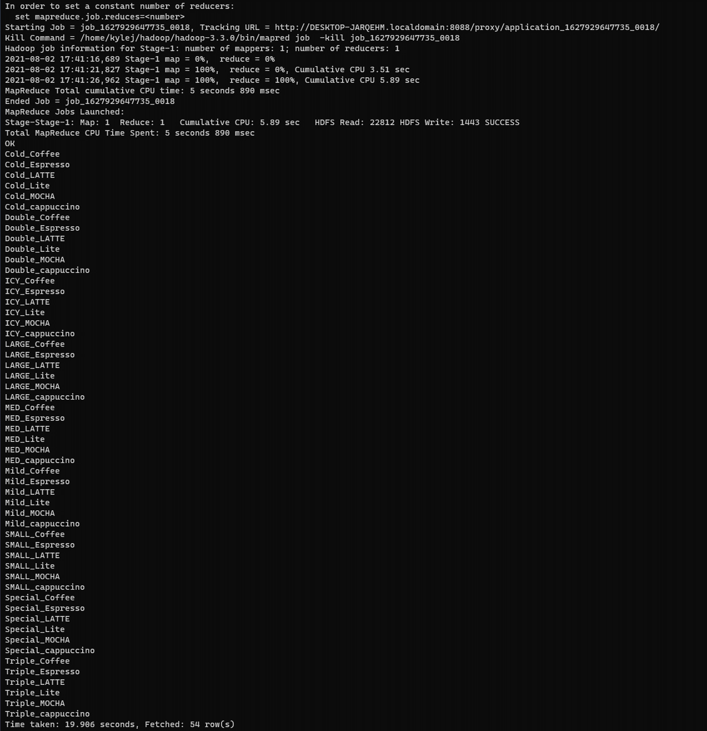
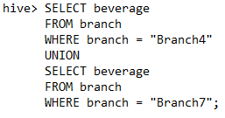
Problem Scenario 3
What are the common beverages available in Branch4,Branch7?

Slide 9
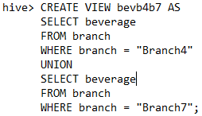


Problem Scenario 4
Create a partition, View for Scenario 3.

Slide 10
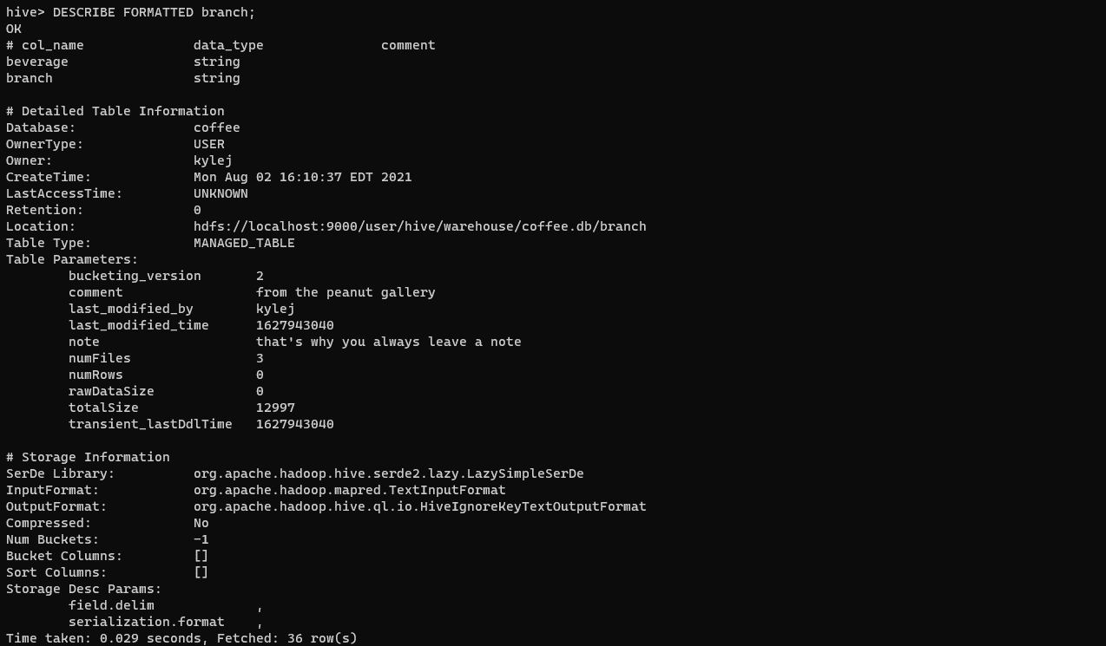
Problem Scenario 5
Alter the table properties to add "note","comment"

Slide 11

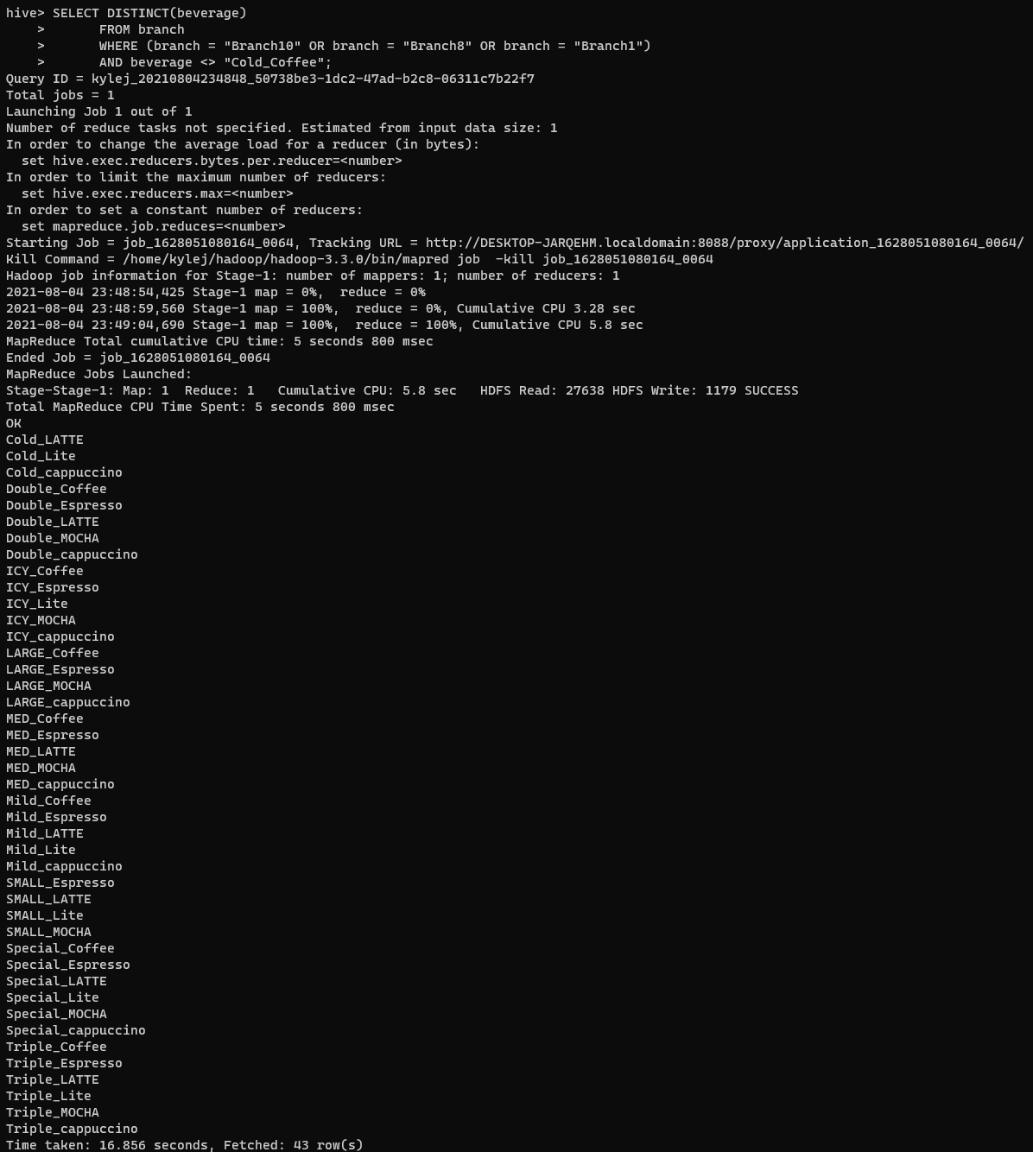
Problem Scenario 6
Remove a row from any Senario

Slide 12
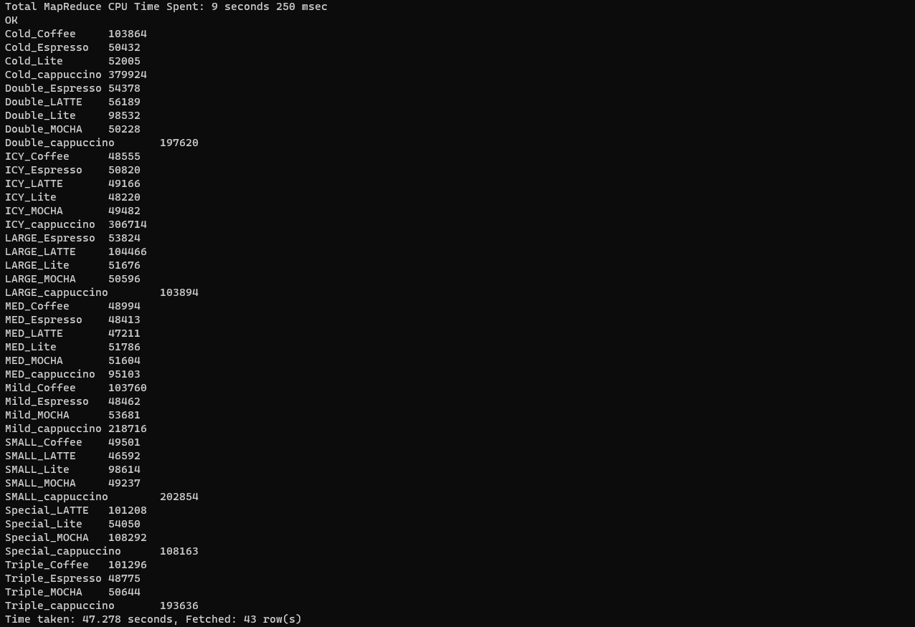
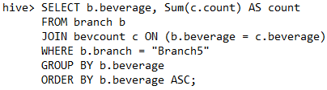
Additional Queries
Select all beverage totals from Branch 5

Slide 13
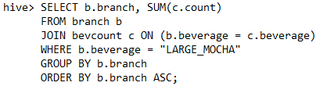
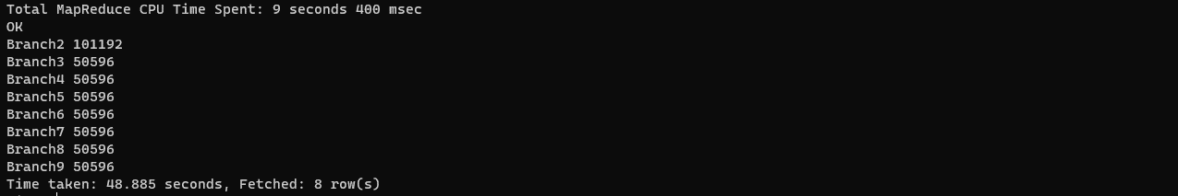
Additional Queries
Select the total Large Mocha sold for each branch

